Slide 1
UNDERSTANDING UBCM’S FUNDING PRORAMS
Presented by Glen Brown, General Manager, Victoria Operations, UBCM & Brant Felker, Manager, Gas Tax Program Services

Slide 2
UBCM Overview
Formed in 1905
2 offices, 27 staff
A policy-based organization
Resolutions
Executive and Special Committees
Member Services
Extended health benefits
Program Services

Slide 3
Program Services
Evaluating prospective programs
The program has clear benefit to local governments
The program, and its design and delivery, is accountable and transparent
UBCM is the appropriate organization to administer the program
UBCM has capacity to undertake program administration and associated duties
Grant Administration
Accepting the program administration builds on existing relationships and does not impair UBCM’s ability to effectively advocate on behalf of our members

Slide 4
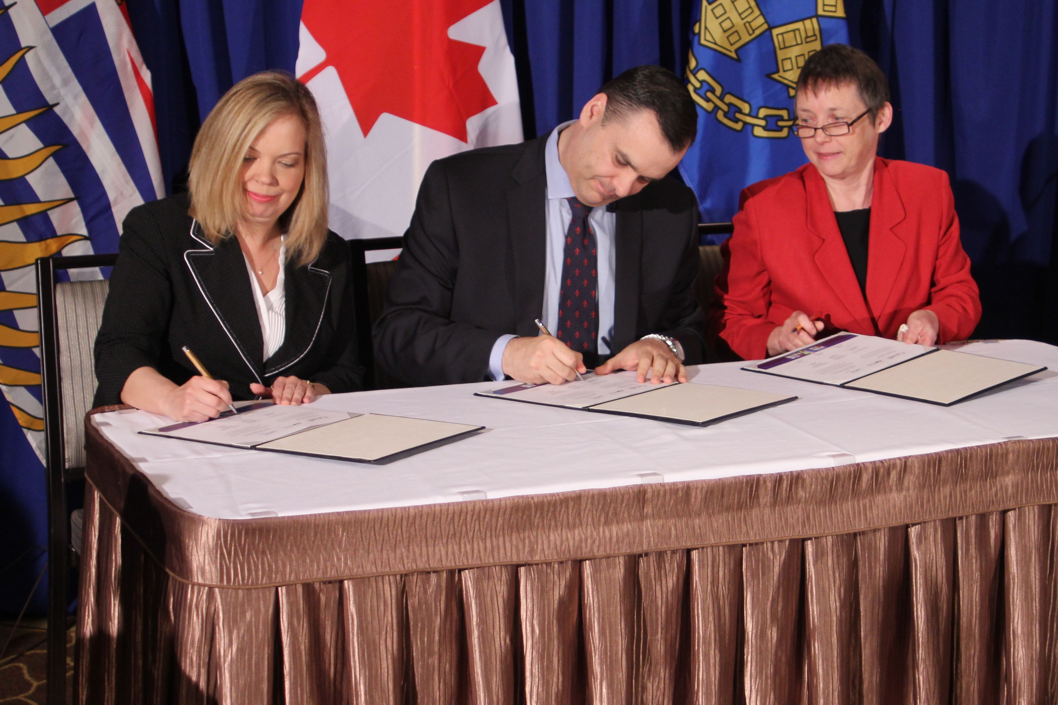
Funding Administered by UBCM
Local Government Program Services
Gas Tax Program Services

Slide 5
Local Government Program Services
Provincially funded programs
Currently administering grants under 17 funding streams under 9 distinct programs and Community Excellence Awards
Committed to transparent processes, clear guidelines, quick turn-around
Aim to offer streamlined application and final report processes
Most programs have intake deadline in fall/winter and review of applications follows in winter/spring
Notes:
8 active programs with 17 funding streams

Slide 6
Current LGPS Funding Programs
Accepting Applications
Community Emergency Preparedness Fund
Emergency Support Services
Emergency Operations Centres & Training
Evacuation Route Planning
Poverty Reduction: Planning & Actions

Slide 7
Community Emergency Preparedness Fund
Emergency Support Services
The intent is to build local capacity to provide emergency support services through training, volunteer recruitment and retention, and the purchase of equipment
Up to $25,000
Application deadline: February 14, 2020
Notes:
Funded by Ministry of Public Safety (Emergency Management BC)
Two intakes completed (2017 and 2019)
As of May 2019 all local governments and First Nations in BC are eligible to apply.
The renewed program in 2020 is emphasizing the modernization of ESS programs to more toward electronic registration and reporting
Example projects include ESS training, cots, blankets, registration computers, signage and ESS team shirts and jackets.

Slide 8
Community Emergency Preparedness Fund
Emergency Operations Centres & Training
The intent is to support the purchase of equipment and supplies required to maintain or improve EOCs and to enhance EOC capacity through training and exercises
Up to $25,000
Application deadline: March 13, 2020
Notes:
Funded by Ministry of Public Safety (Emergency Management BC)
Two intakes completed (2018 and 2019)
As of May 2019 all local governments and First Nations in BC are eligible to apply.
Example projects include EOC section training, EOC training activations, communications equipment, upgraded computer equipment, position vests, wall display monitors, white boards, storage.

Slide 9
Community Emergency Preparedness Fund
Evacuation Route Planning
The intent is to support development of Evacuation Route Plans for communities that would otherwise be challenged to successfully undertake an evacuation operation during an emergency
Up to $25,000
Application deadline: April 17, 2020
Notes:
Funded by Ministry of Public Safety (Emergency Management BC)
One intakes completed (2018)
As of May 2019 all local governments and First Nations in BC are eligible to apply.
Requires the creation of an Evacuation Route Plan
Infrastructure and capital projects (e.g. road building, wildfire fuel management) are not eligible

Slide 10
Poverty Reduction: Planning & Actions
Supports local governments reduce poverty at the local level and support the Province’s poverty reduction strategy
Two Streams:
Poverty Reduction Plans and Assessments, up to $25,000
Poverty Reduction Action, up to $50,000
Application deadline: February 28, 2020
Notes:
Funded by Ministry of Social Development & Poverty Reduction
Program started in 2019 (was announced at 2019 UBCM Convention)
Local government applicants only
Regional projects of multiple eligible applicants can be for up to $150,000

Slide 11
Pending LGPS Funding Programs
Funding Permitting/Confirmation of Intakes
Age-friendly Communities: Planning & Activities
Asset Management Planning
Community Child Care: Planning & Space Creation
Community Emergency Preparedness Fund: Flood Planning, Structural Flood Mitigation, Fire Department Training & Equipment and Indigenous Cultural Safety Training
Community Resilience Investment program
Housing Needs Reports
Regional Community to Community Forum
Urban Communities Partnering for Reconciliation

Slide 12
Age-friendly Communities: Planning & Project Grants
Supports aging populations by developing and implementing policies and plans, undertaking projects that enable seniors to age in place, and facilitating the creation of age-friendly communities
Two Streams:
Age-friendly Assessments, Action Plans & Planning, up to $25,000
Age-friendly Projects, up to $15,000
Funding permitting, next intake will be early 2021
Notes:
Funded by Ministry of Health
Program started in 2004
Previously called Seniors Housing & Support Initiative
Pilot for Indigenous communities introduced in 2019 program (Stream 1 only)
All First Nations and local governments eligible to apply for Stream 1 under 2020 program; only local governments are eligible to apply for Stream 2
Example projects: seniors cooking and nutrition programs, gardens, exercise programs; OCP updates with age-friendly lens, age-friendly community assessments

Slide 13
Asset Management Planning & Training Subsidies
Assist local governments in delivering sustainable services by extending and deepening asset management practices within their organizations.
Up to $15,000, 50% of total project costs
Funding permitting, 2020 intakes to be announced (spring and fall)
Notes:
Funded by Ministry of Municipal Affairs & Housing
Program started in 2014
Local government applicants only
Example projects: developing AM plans, polices and guidelines, staff training and capacity building for AM, AM plans for specific

Slide 14
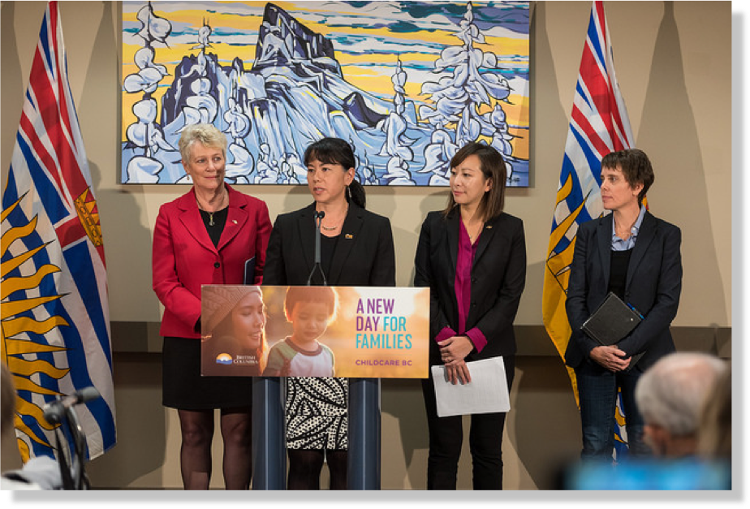
Community Child Care Planning & Space Creation
Community Child Care Planning
Provides funding for local governments to engage in planning activities to develop a child care space creation action plan
Up to $25,000
UBCM is discussing future intakes with MCFD
Notes:
Funded by Ministry of Children & Family Development
Program started in 2019
Local government applicants only
All planning projects must complete a child care space creation action plan and an local child care inventory
Example space creation projects: purchasing/locating modular buildings, renovating existing spaces, adding child care spaces to construction of new community centre
Ministry of Children & Family Development also provides space creation funding and funds can be leveraged

Slide 15
Community Child Care Planning & Space Creation
Community Child Care Space Creation
Provides funding to local governments to create new licensed child care spaces within their own facilities for children aged 0-5, with a focus on spaces for infants and toddlers
Up to $1 million
UBCM is discussing future intakes with MCFD
Notes:
Funded by Ministry of Children & Family Development
Program started in 2019
Local government applicants only
All planning projects must complete a child care space creation action plan and an local child care inventory
Example space creation projects: purchasing/locating modular buildings, renovating existing spaces, adding child care spaces to construction of new community centre
Ministry of Children & Family Development also provides space creation funding and there could be opportunities to match funds

Slide 16
Community Emergency Preparedness Fund
Structural Flood Mitigation
The intent is to prevent, eliminate or reduce the impacts of hazards through construction of structural flood mitigation projects
Up to $750,000
Funding permitting, the next intake will be October 2020
Notes:
Funded by Ministry of Public Safety (Emergency Management BC)
One intake completed (2018)
As of May 2019 all local governments and First Nations in BC are eligible to apply.
It is advisable that applications have all supporting Flood risk assessments, flood mapping, flood mitigation plans and any technical reporting appropriate to support the project rational included with the application.
The more shovel ready a project, the better it will do if the stream is heavily subscribed.
Permitting and authorizations needed should either be in place or discussions begun with appropriate agencies.

Slide 17
Community Emergency Preparedness Fund
Volunteer & Composite Fire Departments Equipment & Training
The intent is to build the resiliency of volunteer and composite fire departments through the purchase of new or replacement equipment, and to facilitate the delivery of training and exercises
Up to $25,000
UBCM is discussing future intakes with EMBC
Notes:
Funded by Ministry of Public Safety (Emergency Management BC)
New funding stream
All local governments and First Nations in BC are eligible to apply. Improvement Districts that operate a fire service and society-run fire departments are also eligible applicants (for this funding steam only)
Structural and interface fire fighting equipment and training only.
FAQ available online.
Ensure your application outlines your fire department’s staffing configuration, and your budget is broken down into types of expenditures.
Outline clearly how the funding will enable project activities you might not otherwise be able to afford.

Slide 18
Community Emergency Preparedness Fund
Indigenous Cultural Safety & Cultural Humility Training
The intent is to provide emergency management personnel with cultural safety and humility training in order to more effectively partner with and provide assistance to Indigenous communities during times of emergency.
Up to $25,000
UBCM is discussing future intakes with EMBC
Notes:
Funded by Ministry of Public Safety (Emergency Management BC)
New funding stream
All local governments and First Nations in BC are eligible to apply.

Slide 19
Community Emergency Preparedness Fund
Flood Risk Assessment, Mapping and Mitigation Planning
The intent is to ensure communities have accurate knowledge of the flood hazards and to develop effective strategies to mitigate and prepare for those risks.
Up to $150,000
UBCM is discussing future intakes with EMBC
Notes:
Funded by Ministry of Public Safety (Emergency Management BC)
Two intakes completed (2017 and 2019)
As of May 2019 all local governments and First Nations in BC are eligible to apply.
Can do one, two or all three activities at once. Do not have to do them in this order if there is a rational for not doing so.

Slide 20
Community Resiliency Investment
CRI is intended to reduce the risk and impact of wildfire to communities in BC through community funding, supports and priority fuel management activities on provincial Crown land.
UBCM administers the FireSmart Community Funding & Supports program
Funding based on risk, from $25,000 - $150,000
Funding permitting, the next intake with be October 2020
Notes:
Funded by Ministry of Forests, Lands, Natural Resource Operations and Rural Development
Program started in 2019 – two intakes have occured
Local government and First Nation applicants
Replaces Strategic Wildfire Prevention Initiative
Funding is scaled to offer eligible applicants with lower risk of wildfire to apply for up to $25,000 and applicants with a demonstrated higher risk of wildfire to apply for up to $150,000 per year.
Funding maximums can be exceeded for eligible fuel management activities on Crown Land

Slide 21
Housing Needs Report Program
Supports local governments in undertaking housing needs reports in order to meet the provincial requirements
Funding based on population
Funding permitting, a third intake will be announced shortly
Notes:
Funded by Ministry of Municipal Affairs & Housing
Program started in 2019 – two intakes have been undertaken
Local government applicants only
Funding is scaled based on the net population of each planning area
Regional projects of multiple eligible applicants can be for up to $150,000
Must result in a housing needs report for at least one entire planning area: municipality, electoral area or local trust area and meet Provincial requirements

Slide 22
Regional Community to Community Forum - C2C
The goal is increased understanding and improved relations between First Nations and local governments.
Supports dialogue to build on opportunities, support reconciliation efforts, resolve issues of common responsibility, interest or concern, and/or to advance tangible outcomes
Up to $5,000, 50% of eligible activities
Funding permitting, the 2020/21 intakes will be announced shortly
Notes:
Funded by Ministry of Municipal Affairs & Housing and Indigenous Services Canada
Program started in 1999
Eligible applicants include local governments and First Nations (Treaty First Nations, bands and Tribal Councils)
Requires participation by elected officials and/or senior staff of local government and neighbouring First Nation

Slide 23
Urban Communities Partnering for Reconciliation Pilot Program
The goal is support reconciliation events and activities with urban (i.e. off-reserve) Indigenous people and organizations and local governments
Up to $10,000, 100% funding
UBCM is discussing future intakes with MIRR
Notes:
Funded by Ministry of Indigenous Relations & Reconciliation
Program started in 2019
Eligible applicants include local governments and eligible Indigenous organizations
Requires participation by elected officials and/or senior staff of local government and Indigenous organization

Slide 24
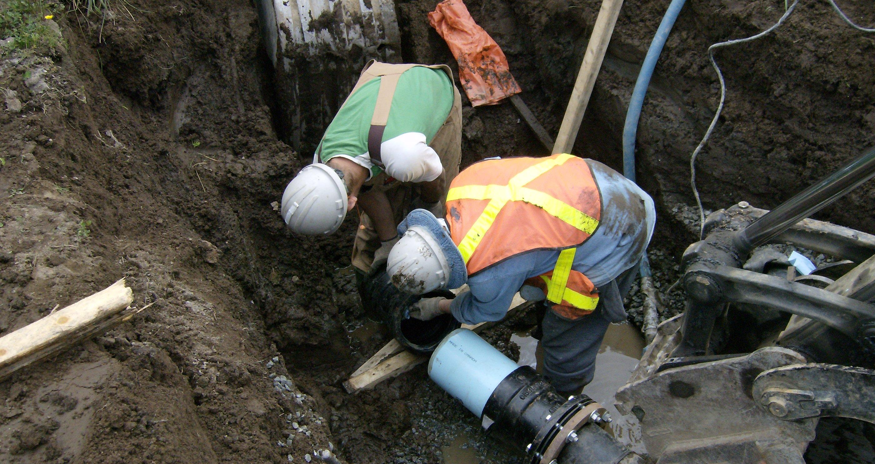
Gas Tax Program Services

Slide 25
Federal Gas Tax Fund
Provides long-term, predictable funding to local governments
$2.2 billion transferred annually across Canada
BC receives an average of $280 million annually
GTF will deliver $4.5 billion to BC from 2005-2024
Over 5,200 projects complete or underway in BC

Slide 26
Chronology
2005: Program implemented by Liberal government, $1.25 billion per year from 2006 to 2010
2007: Extended by Conservative government, $2 billion per year from 2010 to 2014
2011: Legislation enacted to make GTF permanent funding source at $2 billion per year
2013: Legislation enacted to index the fund at 2% annually and the negotiation of the Renewed Agreement
2016: Federal intention to transfer uncommitted funds from other infrastructure programs to GTF recipients
2019: One-time doubling of the GTF

Slide 27
Program Delivery
Gas Tax Fund
Community Works Fund
Strategic Priorities Fund
Greater Vancouver Regional Fund

Slide 28
Program Delivery

Slide 29
Community Works Fund
Delivers funding twice annually to all local governments (July and October)
Local governments make local choices about which eligible projects to fund and report annually on these projects and their outcomes
Funding allocated on a per capita basis ($3 metro /$42 outside metro) with a funding floor ($56,000)
Communities can choose from a set of eligible infrastructure and planning project-types
Accountability based on reporting
One-time top up delivered in 2019

Slide 30
Strategic Priorities Fund
Funding of large, regional or innovative projects outside Metro Vancouver
Funding available for 100% of project cost
Currently, over $300 million is allocated to 175 projects
Program is fully allocated with no timeline for future in-takes

Slide 31
Greater Vancouver Regional Fund
Pooled funding program for projects within the Metro Region
Projects are submitted by TransLink and approved by the Metro Board
Must be identified as transportation related projects

Slide 32
Infrastructure Investment Categories
Local Roads and Active Transportation
Drinking Water
Wastewater
Solid Waste
Sport and Recreation
Public Transit
Community Energy
Culture and Tourism
Disaster Mitigation
Regional Airports
Broadband
Brownfield Redevelopment
Short-sea Shipping and Short-line Rail

Slide 33
Capacity Building Investment Categories
Long-term Infrastructure Planning
Asset Management
Integrated Community Sustainability Plans

Slide 34
Program Statistics
Notes:
Over $2.1 billion in Gas Tax funds expended
$970 million of $1 billion spent on Public Transit is from GVRF

Slide 35
Program Statistics
Notes:
Over 5,000 projects reported since 2005
53/273 Public Transit projects undertaken by TransLink/GVRF

Slide 36
Renewed Agreement Program Statistics

Slide 37
2018 Program Highlights
$318.7 million in local government spending
1003 projects reported spending
$1.6 billion estimated total cost of projects
$398.4 million transferred to recipients
Number of projects and total spending grows every year

Slide 38
2018 Program Highlights
Notes:
$1555 million of $160 million invested in public transit is from GVRF

Slide 39
2018 Program Highlights
Notes:
Over 1,000 projects reported in 2018, a GTF in BC record
Drastic increase in Rec/Sport/Culture/Tourism

Slide 40
Gas Tax Program Resources
Facebook: The Federal Gas Tax Fund in BC
Mention us in your facebook post using @GasTaxFundBC
Tag us in Twitter @UBCM
Website ubcm.ca/gastax

Slide 41
Questions?
LGPS: lgps@ubcm.ca (250) 356-2947
Gas Tax Fund: gastax@ubcm.ca (250) 356-5134
Brant Felker
Gas Tax Policy and Program Manager, UBCM
bfelker@ubcm.ca (250) 356-0893
Danyta Welch
Local Government Program Services Manager, UBCM
dwelch@ubcm.ca (250) 356-5193

