Slide 1
Communicating for Inclusion: How to communicate your decisions when you’re all in favour – and when you’re not
February 7, 2020
Jan Enns, MA
Jan Enns Communications

Slide 2
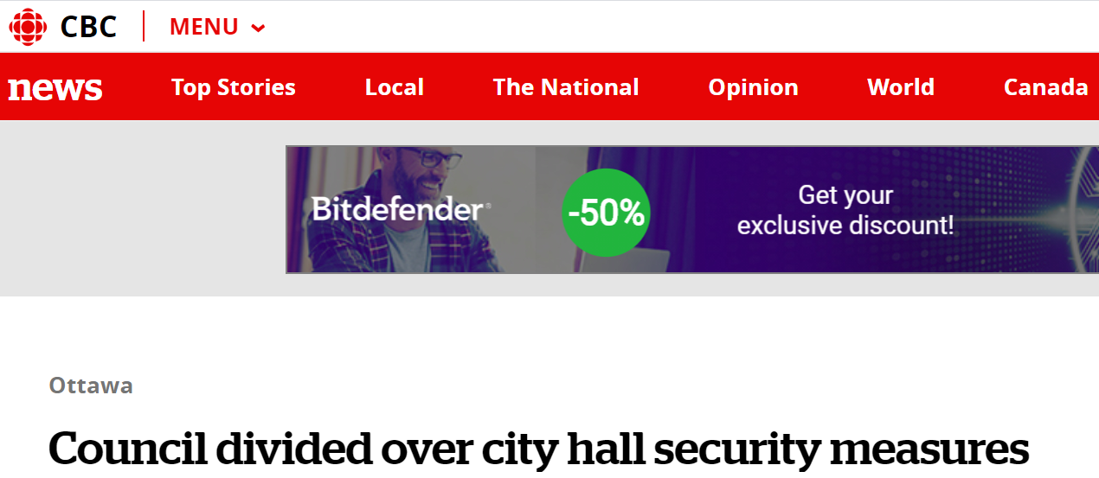

Slide 3
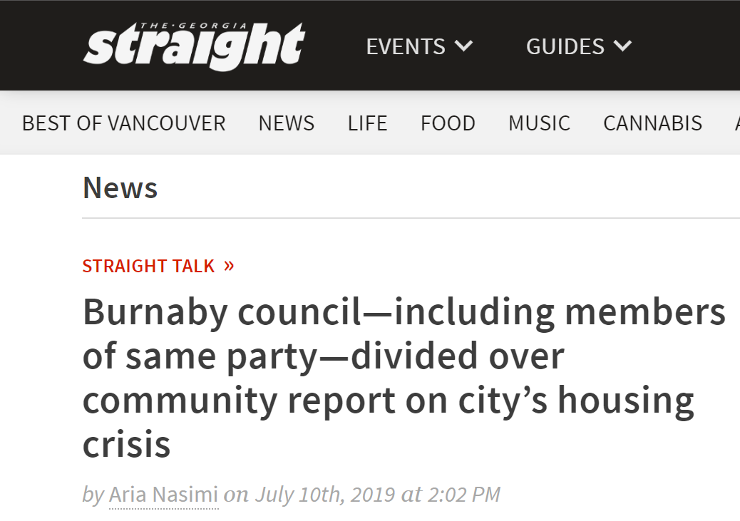
Notes:
https://www.straight.com/news/1264471/burnaby-council-including-members-same-party-divided-over-community-report-citys

Slide 4
Notes:
https://www.therecord.com/news-story/7386468-port-hope-council-divided-on-public-s-response-to-increased-hollywood-attention/

Slide 5
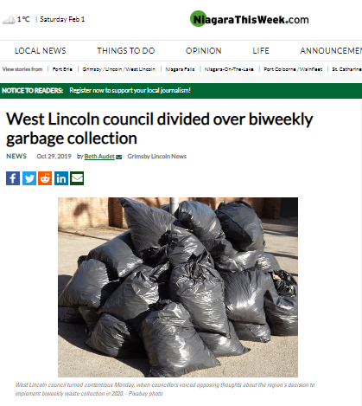
Notes:
https://www.niagarathisweek.com/news-story/9667919-west-lincoln-council-divided-over-biweekly-garbage-collection/

Slide 6
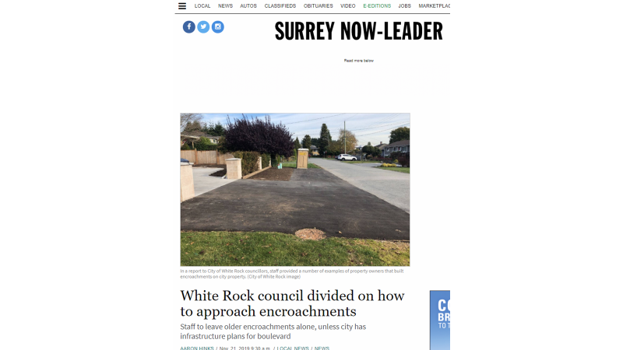

Slide 7
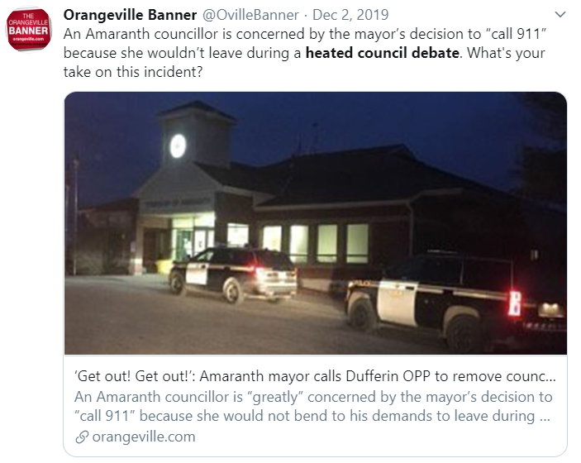
Notes:
https://twitter.com/search?q=heated%20council%20debate&src=typed_query

Slide 8
Notes:
https://inquinte.ca/story/from-the-cheap-seats-report-card-2019

Slide 9
What we’ll cover
Challenges
Opportunities
5 Ideas for action
Breakouts
Notes:
Provide overview of the day…
Handout workbooks

Slide 10
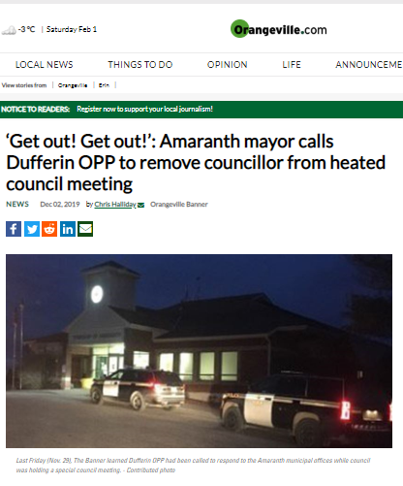
Notes:
https://www.orangeville.com/news-story/9748432--get-out-get-out-amaranth-mayor-calls-dufferin-opp-to-remove-councillor-from-heated-council-meeting/#.XeV8RQGge2M.twitter

Slide 11
What are the challenges with communicating effectively – when in favour or not and why?
Notes:
Why does this matter?
Flipchart – then add points –
Necessary to inform and engage community

Slide 12
What are the challenges with communicating effectively – when in favour or not and why?
Table talk
Record on post it notes
Hear from a few groups
Collect all notes, and send to everyone

Slide 13
#This Matters

Slide 14
Ensure accurate & correct info
Save time & resources

Slide 15
“PMI Study Reveals Poor Communication Leads to Project Failure
One Third of the Time”
Project Management Institute
Notes:
A recent study conducted by the Project Management Institute (PMI) revealed that ineffective communication
has a negative impact on successful project execution
http://bit.ly/16ooE50
See research comm plan, PMI pulse report files

Slide 16
Boost morale
Improve reputation

Slide 17
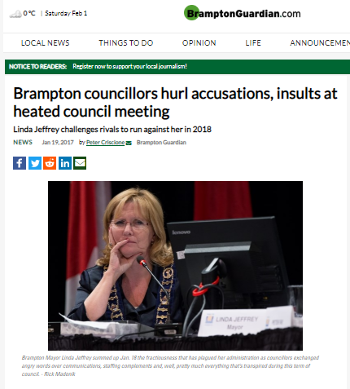
Notes:
https://www.bramptonguardian.com/news-story/7075034-brampton-councillors-hurl-accusations-insults-at-heated-council-meeting/

Slide 18
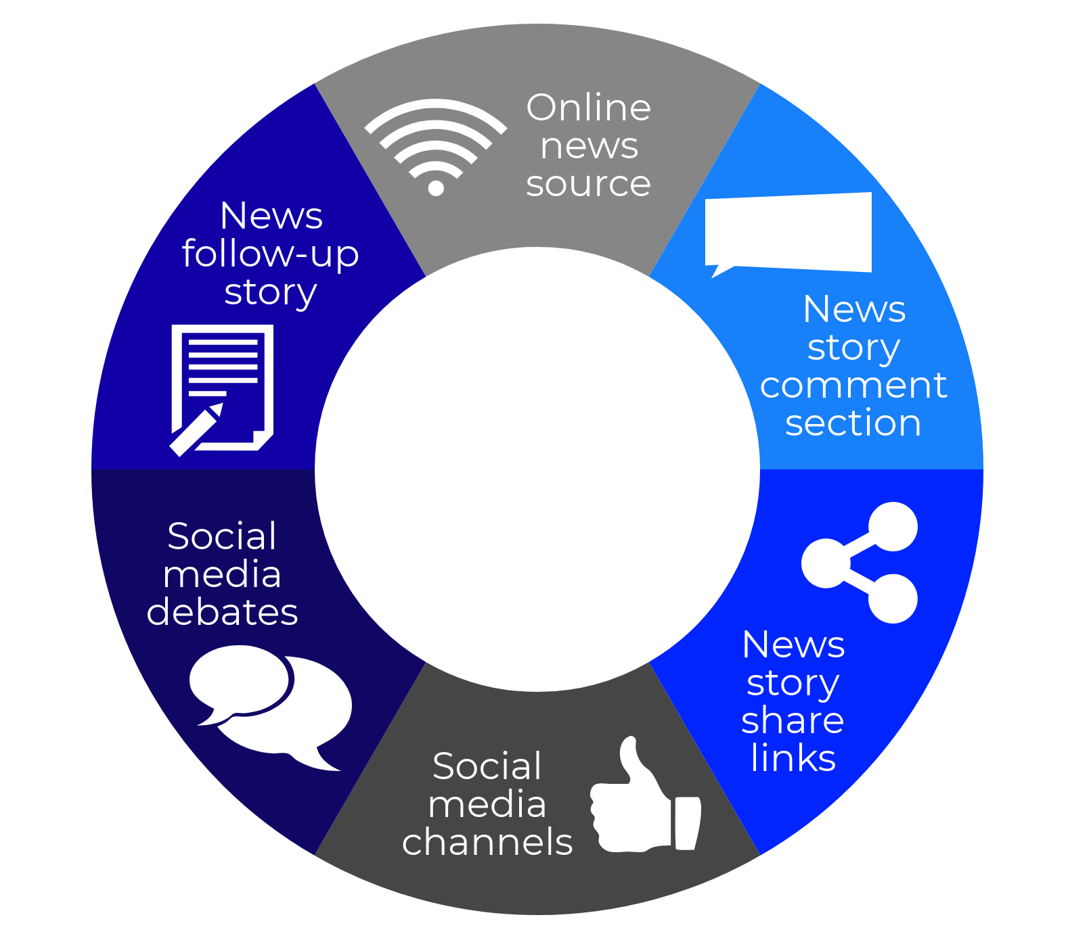
A bigger arena

Slide 20
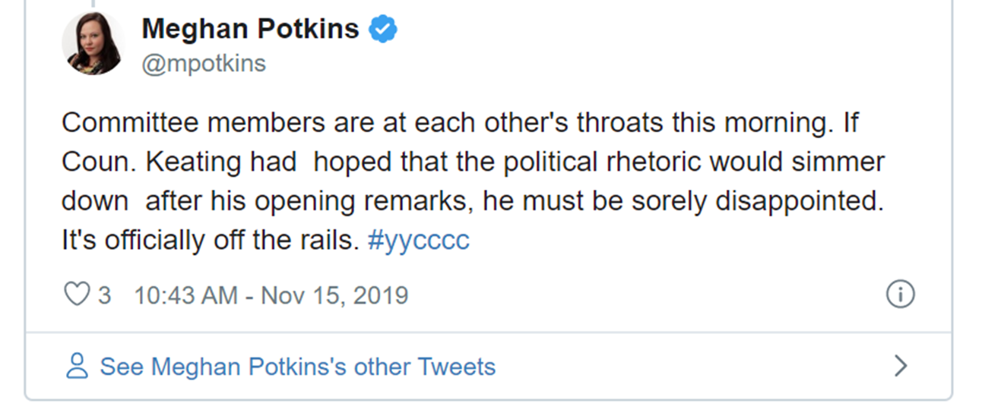

Slide 21
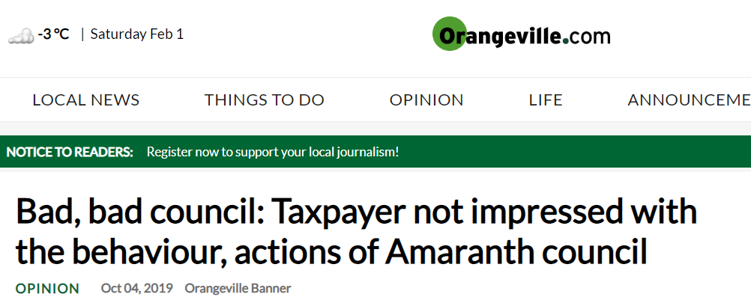
Notes:
https://www.orangeville.com/opinion-story/9629855-bad-bad-council-taxpayer-not-impressed-with-the-behaviour-actions-of-amaranth-council/

Slide 22
Discuss
Deliberate
Debate
Decide
Notes:
Mayor Josie – happy when a good debate! “Well done” - did our job – super respectful – listen to different opinions

Slide 23
5
Start from the inside
Write it down
Be consistent
Spread the word
Try this!

Slide 24
Start your communications from the inside out
1

Slide 25
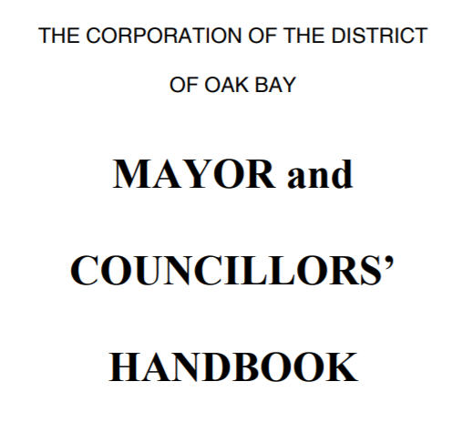
Orientation & check-ins
Notes:
Teambuilding

Slide 27
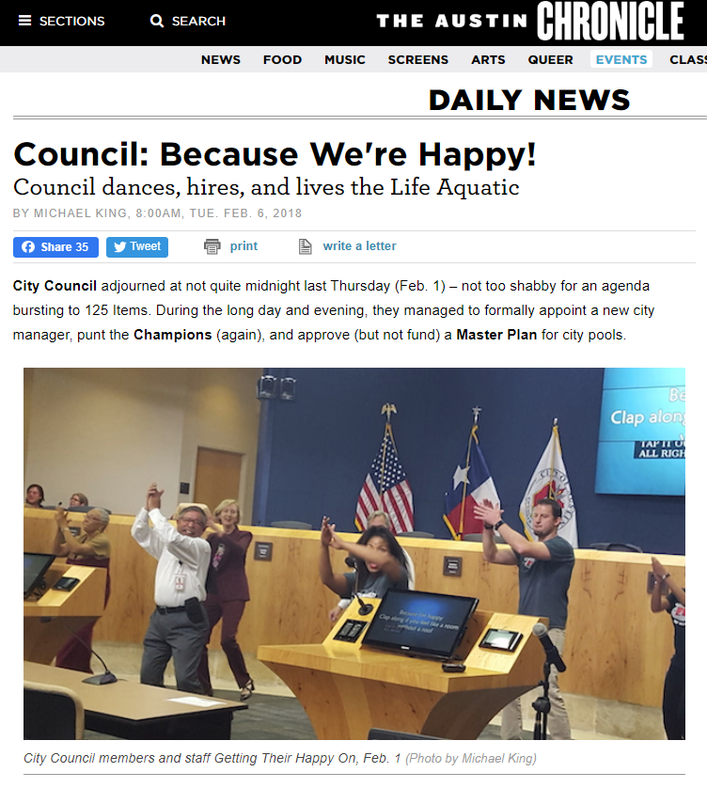
Team building
Notes:
https://www.austinchronicle.com/daily/news/2018-02-06/council-because-we-re-happy/

Slide 28
Put it in writing
2

Slide 29
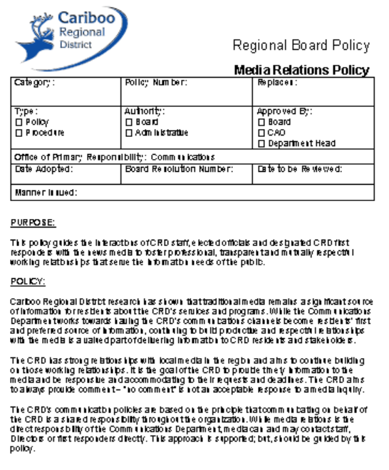
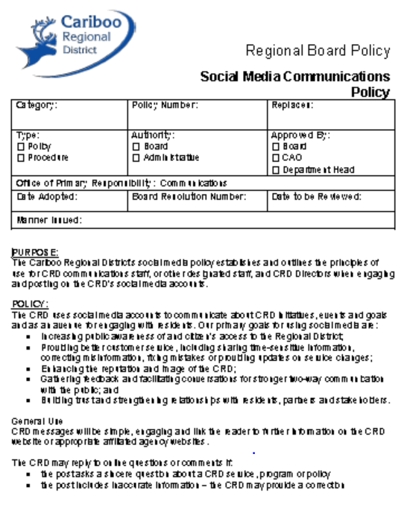
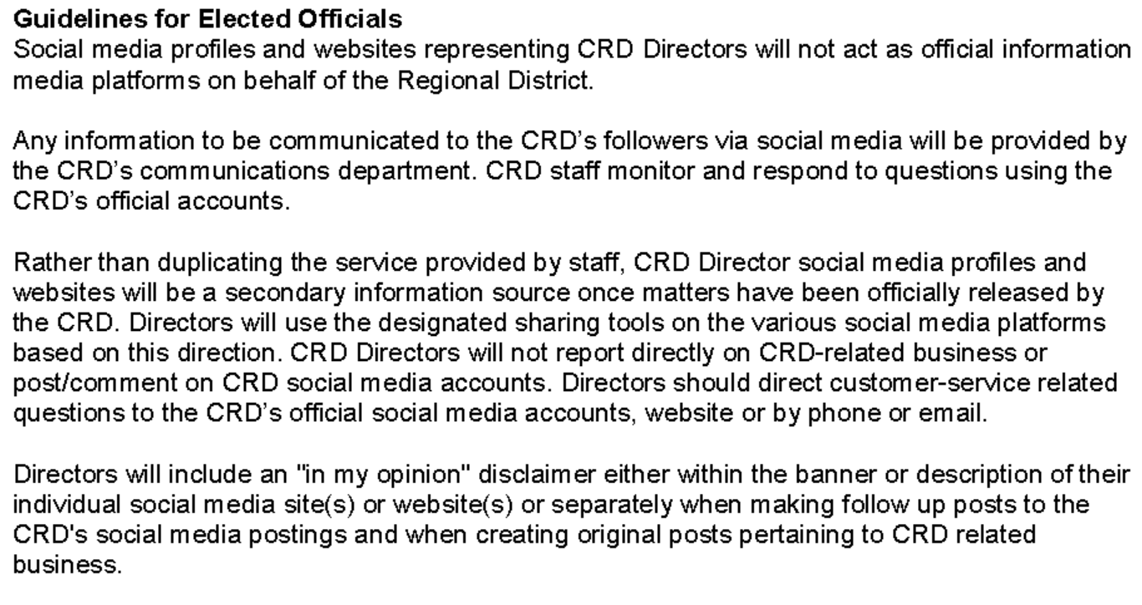
Media & Social Media Policies
Notes:
Who speaks and when
- When representing own opinion
What to share, when and how

Slide 30
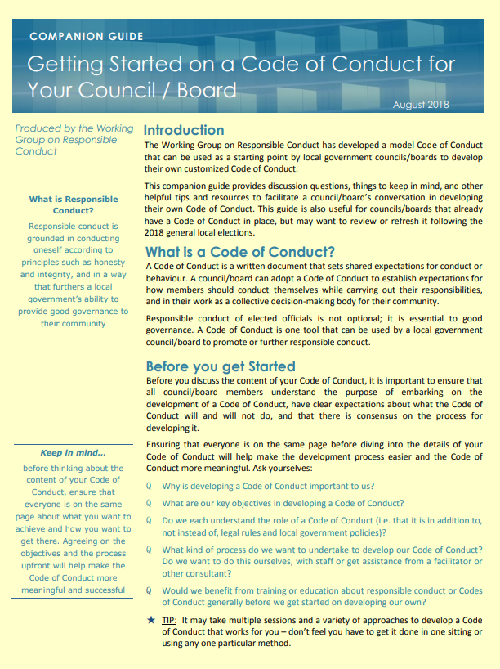
Code of Conduct
Notes:
Goes farther

Slide 31
RDCO Code of Conduct
4.
Notes:
Be nice
Be accurate

Slide 32
City of Kamloops Mayor Christian’s Council Priorities
Notes:
Who has a comms person?
Planning dept?

Slide 33
The basics
Who speaks and when
What to share & when
Represent own opinion
No surprise rule
Notes:
Kamloops vs other communities
Most important – keep your team informed

Slide 34
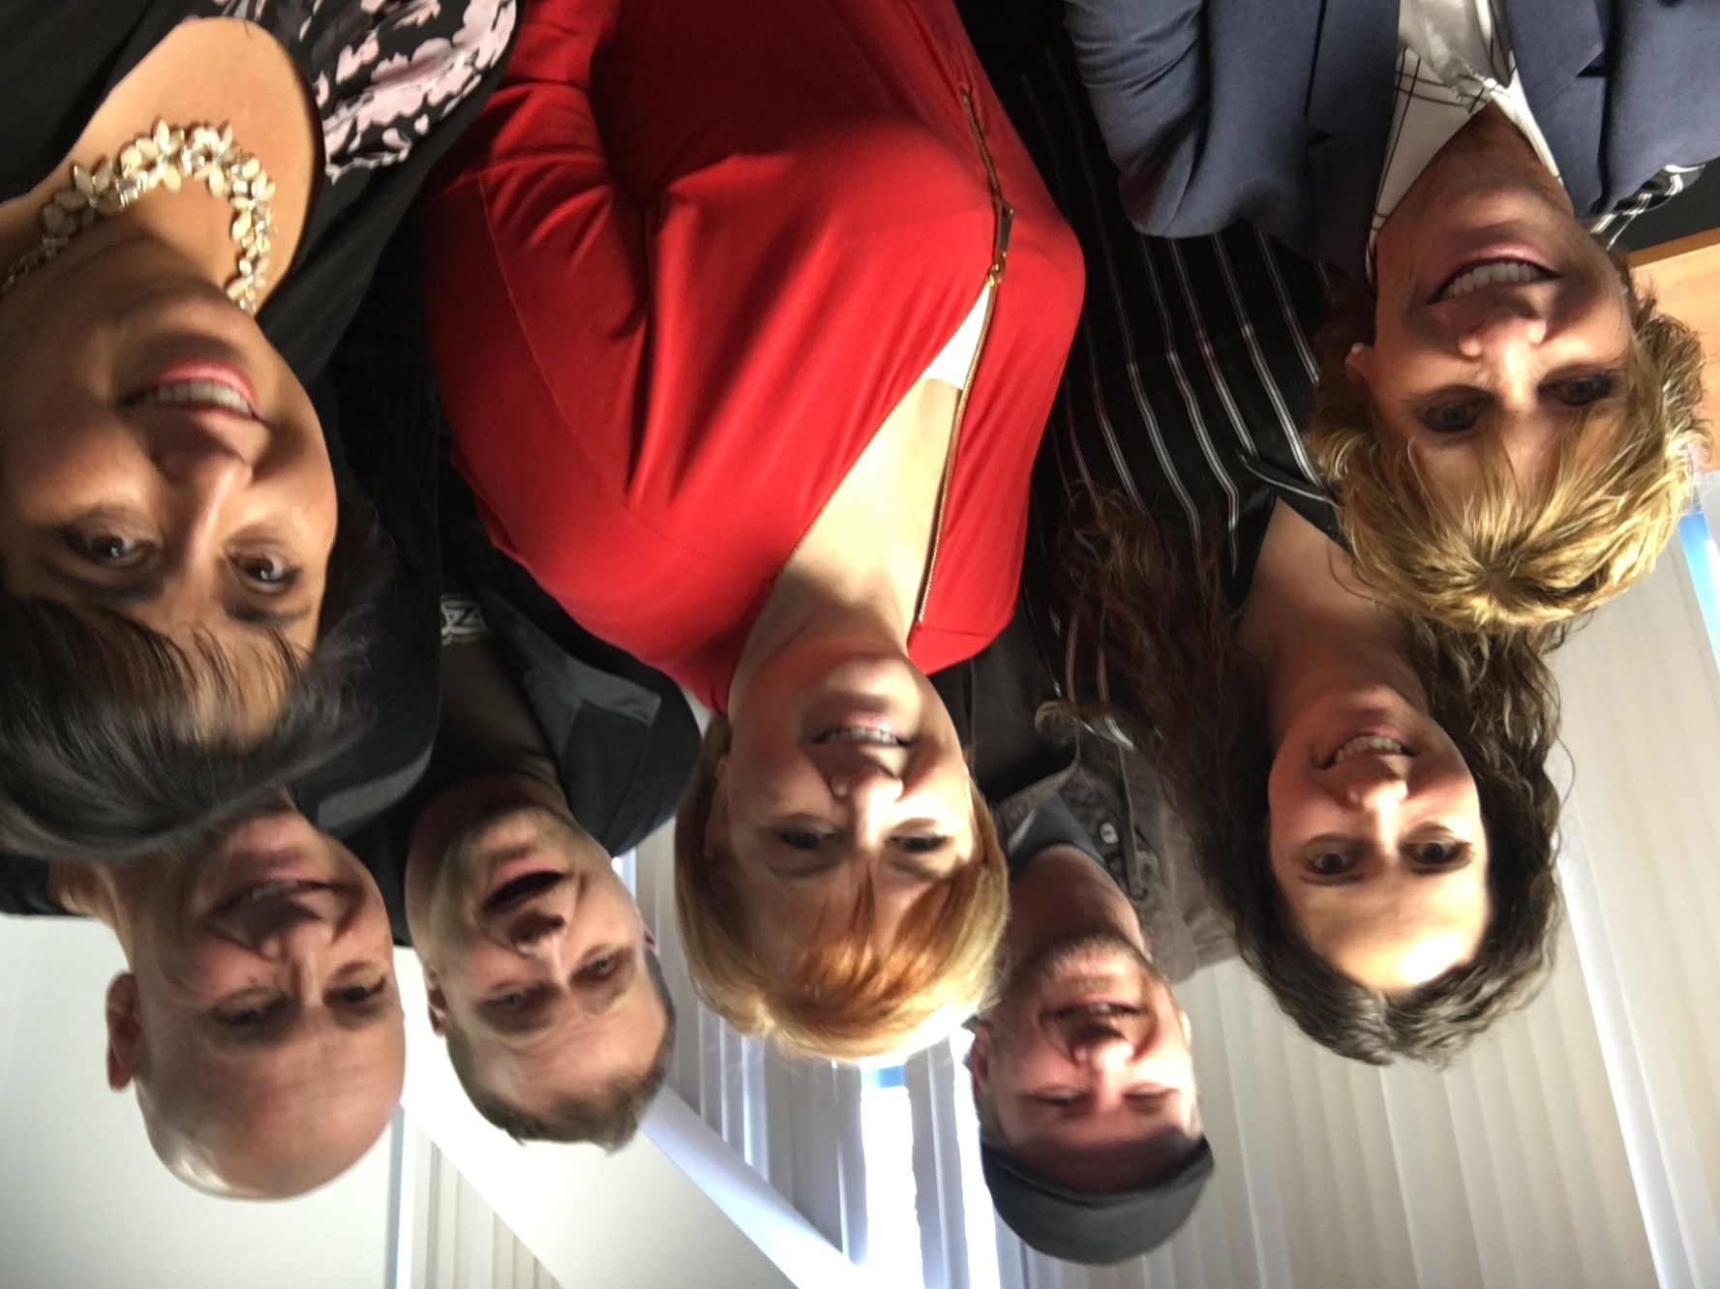
Create together
Check-ins
Team building
In camera meetings
Workshops &training

Slide 35
Be consistent
3

Slide 36
On the same page
Key messages
Talking points
Project updates
FAQs
Urgent emails

Slide 37
Spread the word
4

Slide 38
If your people aren’t being informed by you, there’s a good chance they’ll be misinformed by others. - Patty McCord
Notes:
Named by The Washington Post as one of the 11 Leadership Books to Read in 2018 When it comes to recruiting, motivating, and creating great teams, Patty McCord says most companies have it all wrong. McCord helped create the unique and high-performing culture at Netflix, where she was chief talent officer. In her new book, Powerful: Building a Culture of Freedom and Responsibility, she shares what she learned there and elsewhere in Silicon Valley. McCord advocates practicing radical honesty in the workplace, saying good-bye to employees who don’t fit the company’s emerging needs, and motivating with challenging work, not promises, perks, and bonus plans. McCord argues that the old standbys of corporate HR―annual performance reviews, retention plans, employee empowerment and engagement programs―often end up being a colossal waste of time and resources. Her road-tested advice, offered with humor and irreverence, provides readers a different path for creating a culture of high performance and profitability. Powerful will change how you think about work and the way a business should be run.
Denis E. Waitley, is an American motivational speaker, writer and consultant. He has been recognized as the best-selling author of the audio series, The Psychology of Winning and books such as "Seeds of Greatness" and "The Winner's Edge". Waitley has been inducted into the International Speakers' Hall of Fame. Wikipedia

Slide 39
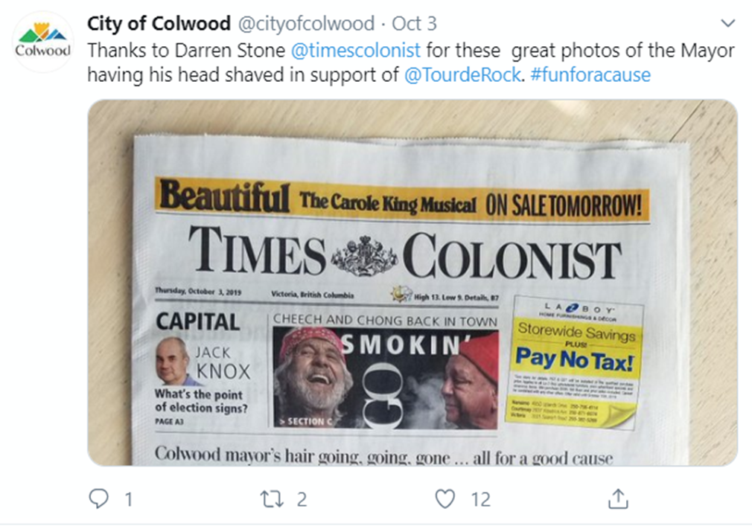
Media: Earned and paid

Slide 40
Print & collateral
Minutes
Council/Board Highlights
Newsletters

Slide 41
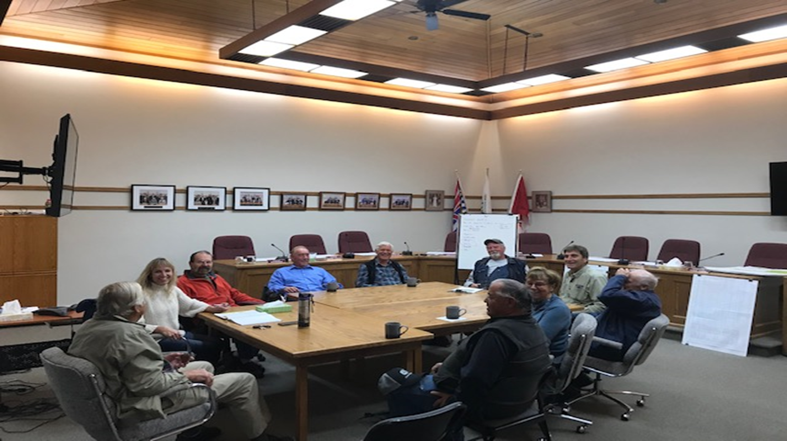
In person
Coffee with the Mayor
~ Mayor Christine Fraser, Township of Spallumcheen

Slide 42
In person
Or a beer…
Notes:
https://www.wtnh.com/on-air/capitol-report/capitol-report-mayor-elicker-hosts-have-a-beer-with-the-mayor/

Slide 44
Online: Website
Online highlights
Meeting videos

Slide 45
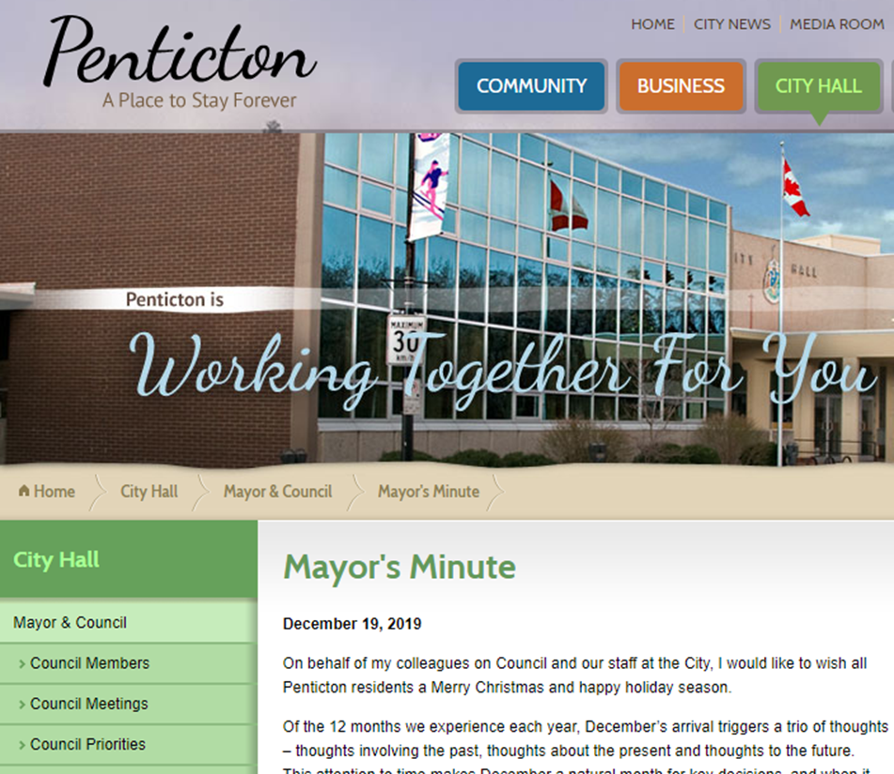
Online
Mayor’s Minute

Slide 46
Online: Social
Share it
Be careful with comments
Link back
Max two responses

Slide 48
Techniques to try
5
Notes:
Newton

Slide 49
#Do
Pay attention
Listen to understand
Notes:
After a crisis or negative incident, many reporters ask a variation of this question: “Can you guarantee this will never happen again?”
The problem with that question is that life offers no guarantees—and no matter what procedures and protocols you put into place, there’s almost always a chance the negative incident could reoccur.
And yet, saying that in an interview can be used against you. If you answer by saying something flip such as, “There are no guarantees in life,” or, “No, we can’t guarantee that,” the resulting story may feature that true but uninspiring line as a pull quote in bold.
In The Media Training Bible, I wrote:
“The best way to answer “guarantee” questions is to talk about what you can guarantee. You usually can’t guarantee a specific result, but you can guarantee that you are committed to something specific—an effort, a policy, or an idea.”
Jan: correct incorrect first (need example)
Mess up, (waste collection)
Jan: Focus on the process tell them what you are doing/going to do – if no outcome known, process)
The CBC issued a statement Saturday saying it does not agree with the views Cherry expressed on Thursday’s HNIC broadcast.
Kirstine Stewart, the CBC's executive vice-president of English services, issued a statement Saturday to reaffirm the network's stance on Cherry and that any opinion expressed by him is his and his alone.
"While we support his right to voice that opinion, we do not share his position," Stewart said.

Slide 50
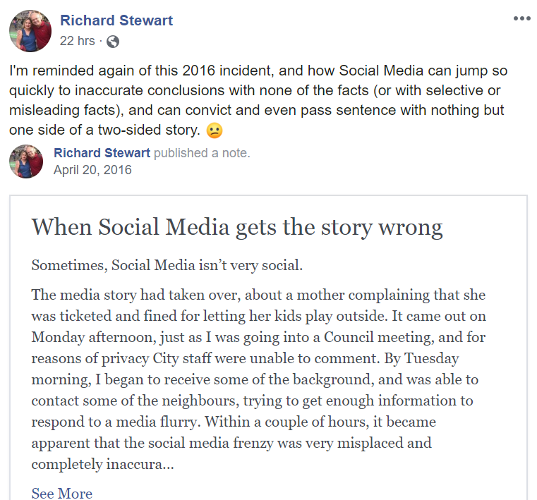
#Do
Correct the incorrect
Focus on the process
Link to video
Notes:
After a crisis or negative incident, many reporters ask a variation of this question: “Can you guarantee this will never happen again?”
The problem with that question is that life offers no guarantees—and no matter what procedures and protocols you put into place, there’s almost always a chance the negative incident could reoccur.
And yet, saying that in an interview can be used against you. If you answer by saying something flip such as, “There are no guarantees in life,” or, “No, we can’t guarantee that,” the resulting story may feature that true but uninspiring line as a pull quote in bold.
In The Media Training Bible, I wrote:
“The best way to answer “guarantee” questions is to talk about what you can guarantee. You usually can’t guarantee a specific result, but you can guarantee that you are committed to something specific—an effort, a policy, or an idea.”
Jan: correct incorrect first (need example)
Mess up, (waste collection)
Jan: Focus on the process tell them what you are doing/going to do – if no outcome known, process)
The CBC issued a statement Saturday saying it does not agree with the views Cherry expressed on Thursday’s HNIC broadcast.
Kirstine Stewart, the CBC's executive vice-president of English services, issued a statement Saturday to reaffirm the network's stance on Cherry and that any opinion expressed by him is his and his alone.
"While we support his right to voice that opinion, we do not share his position," Stewart said.

Slide 51
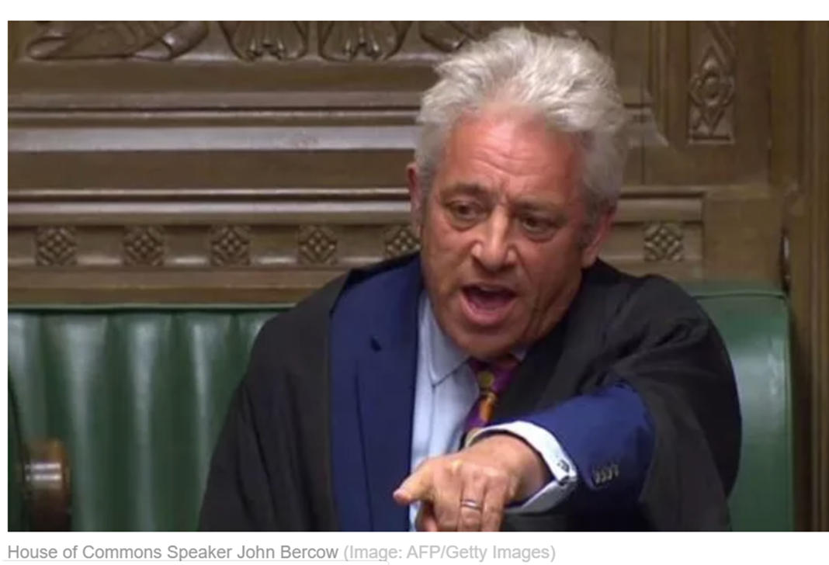
#Do
Be sensitive to your audience:
Colleagues at the table
Staff
Community
Process
Notes:
House of Commons Speaker John Bercow: https://www.youtube.com/watch?v=O-djMYYIvyE&pbjreload=10
After a crisis or negative incident, many reporters ask a variation of this question: “Can you guarantee this will never happen again?”
The problem with that question is that life offers no guarantees—and no matter what procedures and protocols you put into place, there’s almost always a chance the negative incident could reoccur.
And yet, saying that in an interview can be used against you. If you answer by saying something flip such as, “There are no guarantees in life,” or, “No, we can’t guarantee that,” the resulting story may feature that true but uninspiring line as a pull quote in bold.
In The Media Training Bible, I wrote:
“The best way to answer “guarantee” questions is to talk about what you can guarantee. You usually can’t guarantee a specific result, but you can guarantee that you are committed to something specific—an effort, a policy, or an idea.”
Jan: correct incorrect first (need example)
Mess up, (waste collection)
Jan: Focus on the process tell them what you are doing/going to do – if no outcome known, process)
The CBC issued a statement Saturday saying it does not agree with the views Cherry expressed on Thursday’s HNIC broadcast.
Kirstine Stewart, the CBC's executive vice-president of English services, issued a statement Saturday to reaffirm the network's stance on Cherry and that any opinion expressed by him is his and his alone.
"While we support his right to voice that opinion, we do not share his position," Stewart said.

Slide 52
Notes:
House of Commons Speaker John Bercow: https://www.youtube.com/watch?v=O-djMYYIvyE&pbjreload=10
After a crisis or negative incident, many reporters ask a variation of this question: “Can you guarantee this will never happen again?”
The problem with that question is that life offers no guarantees—and no matter what procedures and protocols you put into place, there’s almost always a chance the negative incident could reoccur.
And yet, saying that in an interview can be used against you. If you answer by saying something flip such as, “There are no guarantees in life,” or, “No, we can’t guarantee that,” the resulting story may feature that true but uninspiring line as a pull quote in bold.
In The Media Training Bible, I wrote:
“The best way to answer “guarantee” questions is to talk about what you can guarantee. You usually can’t guarantee a specific result, but you can guarantee that you are committed to something specific—an effort, a policy, or an idea.”
Jan: correct incorrect first (need example)
Mess up, (waste collection)
Jan: Focus on the process tell them what you are doing/going to do – if no outcome known, process)
The CBC issued a statement Saturday saying it does not agree with the views Cherry expressed on Thursday’s HNIC broadcast.
Kirstine Stewart, the CBC's executive vice-president of English services, issued a statement Saturday to reaffirm the network's stance on Cherry and that any opinion expressed by him is his and his alone.
"While we support his right to voice that opinion, we do not share his position," Stewart said.

Slide 53
#Do
Be sensitive to your audience:
Colleagues at the table
Staff
Community
Process
Notes:
House of Commons Speaker John Bercow: https://www.youtube.com/watch?v=O-djMYYIvyE&pbjreload=10
After a crisis or negative incident, many reporters ask a variation of this question: “Can you guarantee this will never happen again?”
The problem with that question is that life offers no guarantees—and no matter what procedures and protocols you put into place, there’s almost always a chance the negative incident could reoccur.
And yet, saying that in an interview can be used against you. If you answer by saying something flip such as, “There are no guarantees in life,” or, “No, we can’t guarantee that,” the resulting story may feature that true but uninspiring line as a pull quote in bold.
In The Media Training Bible, I wrote:
“The best way to answer “guarantee” questions is to talk about what you can guarantee. You usually can’t guarantee a specific result, but you can guarantee that you are committed to something specific—an effort, a policy, or an idea.”
Jan: correct incorrect first (need example)
Mess up, (waste collection)
Jan: Focus on the process tell them what you are doing/going to do – if no outcome known, process)
The CBC issued a statement Saturday saying it does not agree with the views Cherry expressed on Thursday’s HNIC broadcast.
Kirstine Stewart, the CBC's executive vice-president of English services, issued a statement Saturday to reaffirm the network's stance on Cherry and that any opinion expressed by him is his and his alone.
"While we support his right to voice that opinion, we do not share his position," Stewart said.

Slide 54
Empathy
is your superpower
Notes:
Especially when responding

Slide 55
#Do
Take time to think
Breathe
Notes:
: Be available
Stay on message – it’s what Brad Phillips calls the “7 Second Stray” – that what will get picked up!
Jan: bottom three
: Mess up, (waste collection)
(tell them what you are doing/going to do – if no outcome known, process)

Slide 56
Techniques to try
While you know I voted against this, now that the decision has been made, my job is to help make sure it is done as efficiently and as cost-effective as possible.

Slide 57
Techniques to try
While Council/Board decided to move forward with the project, I voted against it. That said, there were many valid perspectives around the table that were taken into account in the discussion, and the majority voted in favour.

Slide 58
Techniques to try
I recognize there are different perspectives around the table. What I believe is important is …
While I would have liked the vote to turn out differently, this is how the democratic process works.

Slide 59
Techniques to try: Bridging
Bridge the gap to a new topic or point
“While I don’t have that information, what I can tell you is…”
“While I don’t know the answer to that particular question, I can put you in touch with…”
Notes:
Jan: Three techniques – will need examples for each one
A couple of great bridges are “What we’re focusing on is” and “Some people may look at it that way, but here’s what we do know”. These are both great ways to lead into your key message.

Slide 60
Techniques to try: Flagging
Draw attention to a specific point you want to be sure to get across (your key message!)
“What’s important to point out is…”
“We are working to focus on…”
“What people need to know is …”

Slide 61
It is wise to direct your anger towards problems – not people; to focus your energies on answers – not excuses. - William Arthur Ward
Notes:
Denis E. Waitley, is an American motivational speaker, writer and consultant. He has been recognized as the best-selling author of the audio series, The Psychology of Winning and books such as "Seeds of Greatness" and "The Winner's Edge". Waitley has been inducted into the International Speakers' Hall of Fame. Wikipedia

Slide 62
What could we do better to communicate inclusively when we are all in favour – and when we’re not?
Table talk
What works for you?
What could be better?
Record on post it notes
Hear from a few groups
Collect all notes, and send to everyone

Slide 63
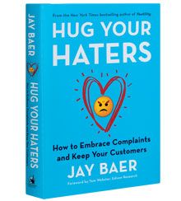

Slide 64
You can have brilliant ideas, but if you can’t get them across, your ideas won’t get you anywhere. - Lee Iacocca
Notes:
Denis E. Waitley, is an American motivational speaker, writer and consultant. He has been recognized as the best-selling author of the audio series, The Psychology of Winning and books such as "Seeds of Greatness" and "The Winner's Edge". Waitley has been inducted into the International Speakers' Hall of Fame. Wikipedia

